Slide 1

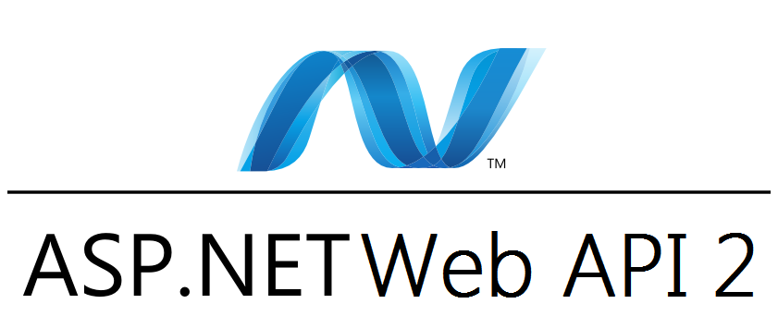
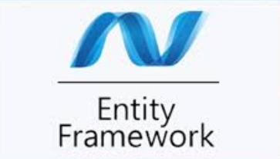
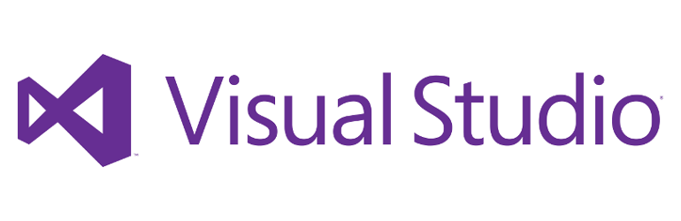
Web API 2.0
Implement First Bound Context Using Entity Framework

Slide 2
Why Entity Framework
It provides auto generated code
EF has fully automated code generation engine. When we define a model or mapped to an existing database, it will automatically create model or database.
It provides capability of programming a conceptual model.
We can make a code first model conceptually and expand it when business model changes. When this happens EF will generate the relevant code automatically using minimum command set
It provides unique syntax (LINQ) for all object queries whether it is database or not
When an object mapped to an database entity we need to query those data. EF fully support the LINQ query engine and it will provide a rich set of DB queries . When we get in-memory list of objects LINQ will also provided those set of functions.
It allow multiple conceptual models to mapped to a single storage schema
Assume we have 2 models that need to combine in to one database. EF will provide set of tools to combine more models to one database schema.

Slide 3
Model Types in EF
Database First
If you already have a database, the Entity Framework can automatically generate a data model that consists of classes and properties that correspond to existing database. The information about your database structure, your data model, and the mapping between them is stored in XML in an .edmx file.
Model First
If you don't yet have a database, you can begin by creating a model using the Entity Framework designer in Visual Studio. When the model is finished, the designer can generate DDL (data definition language) statements to create the database. This approach also uses an .edmx file to store model and mapping information.
Code First
Whether you have an existing database or not, you can code your own classes and properties that correspond to tables and columns and use them with the Entity Framework without an .edmx file. That's why you sometimes see this approach called code only, although the official name is Code First. The mapping between the store schema and the conceptual model represented by your code is handled by convention and by a special mapping API. If you don't yet have a database, the Entity Framework can automatically create the database for you, or drop and re-create it if the model changes.

Slide 4
We are planning to use Code-first approach …
Ask me why?

Slide 5
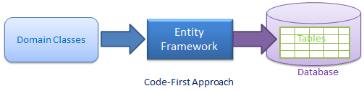
Code-First Model
Code-First approach, you can focus on the domain design and start creating classes as per your domain requirement rather than design your database first and then create the classes which match your database design
What that means is you can create some classes right away and create a database using that classes. This collection of class we call Context or Model. These classes are interconnected and implement single responsibility principle.
SRP – single responsible principle means that each class of the context has very specific and task oriented responsibility. In other word each class will do one thing and do that perfectly . When implemented code is more cleaner and easy to others to handle.
Because this context handled automatically when ever changed, code first model is the best choice for RAD – Rapid application development. You will see this in action later on.

Slide 6
Requirement Document
An elite software engineer don’t just jump in to coding. They are keen to details and first examine the business model . Because of the RAD environment they are not wasting time for dig deeper. Instead they scratch the surface and make a requirement document.
GigHub is a mini social network that makes it really easy for live music lovers to track the gigs of their favorite artists.
Artists can sign up and list their gigs. When adding a gig, they should specify the date and time, location, and genre of the gig.
An artist should have a page called My Upcoming Gigs. From there, they should be able to edit or remove an existing gig, or add another one to the list.
Users should be able to view all upcoming gigs or search them by artist, genre, or location.
They should be able to view the details of a gig and add it to their calendar. Additionally, users should be able to follow their favorite artists. When they follow an artist, they should see the upcoming gigs of their favorite artists in the Gig Feed.
This is a simple requirement document. The next step will be extracting the use cases from the list.

Slide 7
Get a paper and try to extract use-cases as much as you can!!

Slide 8
Extracting use-cases
From the list we clearly see we need some authentication work done. So we create a separate component for that
Sign Up
Log in
Log out
Change password
Edit Profile
Clearly we can see we need to handle gigs . And we can put it in a separate component
Add a gig
Upcoming gigs (for artist) – need separate one for artist
Remove a gig
View all upcoming gigs
Search (there can be a lot of gigs . So at this point it’s better to implement a search)
View gig details

Slide 9
We need gigs on calendar .
Add a gig to calendar
Remove a gig from calendar
View gigs I am attending (for users)
Users need to follow artists. So there must be a place to them
Follow an artist
Unfollow an artist
Who’s I am following
Gig feed (we need a central place for this gigs . So gig feed will be it )

Slide 10
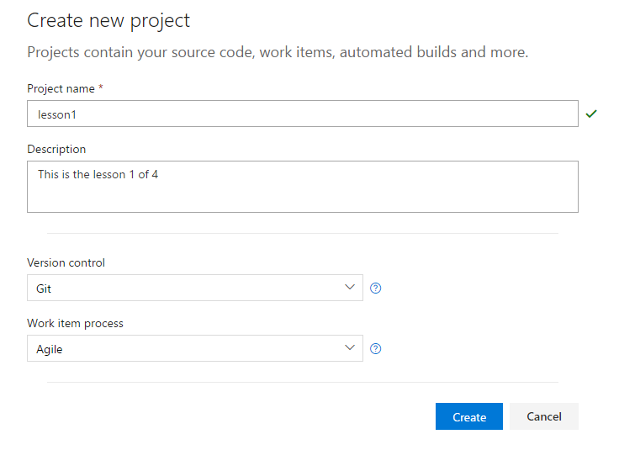
Visual studio Team Foundation Online
To make things done in proper manner we must implement a collaboration pattern. So for Microsoft products TFS is a batter choice at all.
You can use your cooperate TFS or Visual studio online version of TFS. I use TFS online for this lesson.
Log in to your visual studio online and create a new project. You can use either GIT or tfs it self to handle version control. I use git.
Put name and version control as GIT
Work item project will be agile. When you use scrum master you cannot do testing. So use agile instead.
Then create the project. And you will redirect project’s dashboard

Slide 11
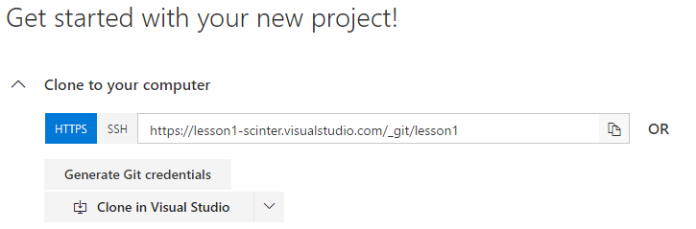
Little Bit of GIT
GIT is an open source version control system that is now no 1 in the world. Most of the open source repositories reside here . Most of the best developers are participating for development in here.
You will need GIT for windows and GIT bash for start development using GIT in windows. Go to these links and download those.
Git bash - https://git-scm.com/download/win
Git desktop- https://desktop.github.com/
GIT bash is a command line tool and GIT desktop is UI tool. I will show you how to do this in GIT desktop. But you have to master GIT bash to be more elite
In the your vs online project dashboard there is a link says clone this repo. Copy that link and put it in the GIT desktop tool by go to file >> Clone Repository

Slide 12
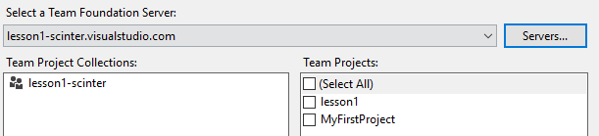
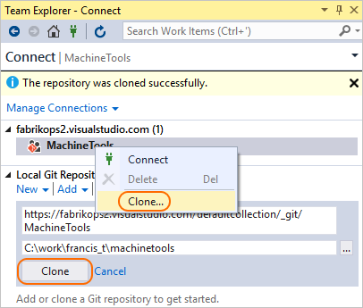
Go to visual studio and go to team explorer. Then manage connections .
Clone the repository to a local folder.
Now all done and set for development

Slide 13
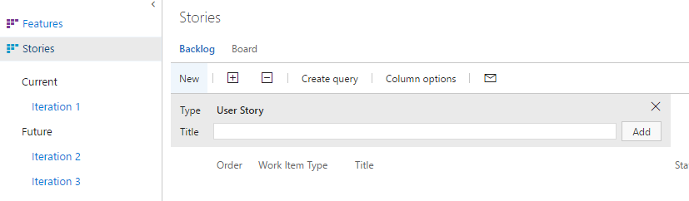
Adding Use-cases to backlog
Backlog is something like to-do list. We add all our planed to-do things in here. So we know what has to be done to achieve targets .
So go to work >> backlog in the dashboard
Add all your planned use-cases in here for future references . Then later on we can add these in to iterations and start working on iterations.

Slide 14
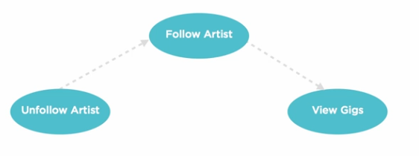
Dependency and Order of the Use-Cases
We need to find out what are the dependencies between each use cases and arrange them less dependence first wise .find out the number of occurrences.
Then order them like showing in following table
1 | 2 | 3 | 4 | 5
Add a gig | View Upcoming Gigs All upcoming gigs | Edit a gig Remove a gig Add a gig to calendar Follow an artist Search View gig details | View gigs I’m attending Who I am following | Remove a gig from calendar Unfollow and artist
Add a gig is the most fundamental use case. So it need to implement at the first iteration. In other words if we didn’t add a gig how can we view upcoming gigs? Or remove a gig?
So this order in the iterations of our work phase.

Slide 15
Extract use-cases and planning first Iteration
Let’s remind our last use cases. And find out core use-cases and put them in the first iteration. because without them we cannot implement rest of the use-cases. So let’s do it now. We do it by find out what use-case effect to change our domain model.
“Add a gig” is the base of all use cases. So we put it top of the stack
In the 3rd column edit a gig and remove a gig kind of similar to add a gig. So there will be no impact on domain model.
But “Add a gig to calendar” will has some effects to the model. So we put it next to the stack . Also “Follow an artist” has the same effect .
These 3 are the only core use cases . But if we implement these 3 in our first iteration , it will be incomplete . On the other hand we cannot see this iteration to client . They will not see a functioning unit in this
So for supporting use-cases for above 3 we get “All upcoming gigs” from second column . Also “view gigs I am following” and “Who I am following” gigs from the 4th column .
Now we can move these 6 back log items to first iteration and process that iteration

Slide 16
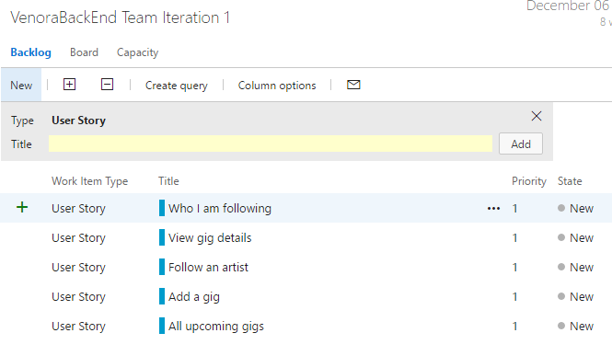
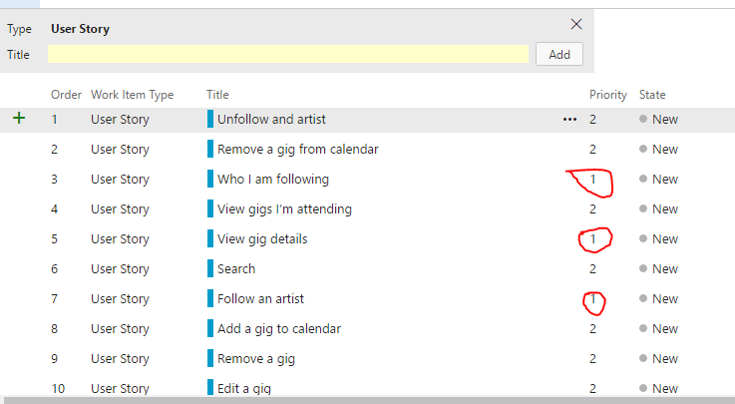
Adding Use-Cases to Iterations
1st Priority use cases list
We can first add all our use-cases to the backlog and then prioritize them accordingly and move them in to first iteration
Add a gig
All upcoming gigs
Add a gig to calendar
Follow an artist
View gigs I’m attending
Who I am following

Slide 17
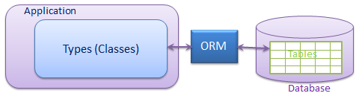
Entity Framework and Migrations
Microsoft Definition
The Microsoft ADO.NET Entity Framework is an Object/Relational Mapping (ORM) framework
that enables developers to work with relational data as domain-specific objects, eliminating the need for most of the data access plumbing code that developers usually need to write
Object/Relational Mapping (ORM) What this means is that if you have a class called customer and fields and methods of that class will be mapped to a database table columns. Each row of that table will be a object inside the program.
eliminating the need for most of the data access plumbing code with ado.net you have to write data access methods involving connection , command objects , data adapters and readers . There are lot more things to get all columns of a table in to collection of objects inside a program. But with this kind of mapping EF will take care of all the connection , command objects , data adapters and readers things and you just have to do is to give EF the filtering criteria.
Migration means that EF has power to update database when ever your model changes.

Slide 18
Configure EF first time
Since we are planning to implement n-tire architecture we separate the system in to few peaces. In this stage we planning
Data access
Model
We can implement EF in data access component. First of all we have to create our Model.
In order to implement data access component we first have to implement the domain model of our project
Then we add all the models to EF model that will represent In-memory database of our actual database. The only different is that EF Model does not have data yet. But it has all the schema mappings and predefined query parameters already written behind the scene

Slide 19

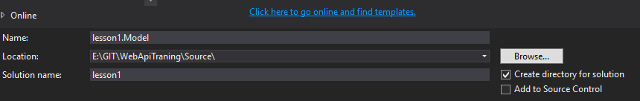
Enough talking let’s do some coding
We use Visual Studio 2005 Enterprise edition for this lessons. because other editions does not support Architecting tools
Open the vs 2015 and chose new Project from the startup.
For the Name enter “lesson1.Model” and for the solution name as “lesson1”
What this does is that it makes the solution as lesson1 and then created project name “lesson1.Model” inside the solution. This is the best practice and we keep a proper naming convention for our name spaces
The default namespace for the project will be “lesson1.Model”

Slide 20

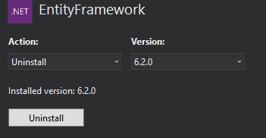

Adding Entity Framework to Project
Adding EF is very easy. Right click on the solution and click “Manage NuGet packages for solution”.
Then in the second of the list or in first screen depending on the vs version there is a item call EntityFreamwork.
Then NuGet manager will take care of the rest and will add the EF to the reference array of the project

Slide 21
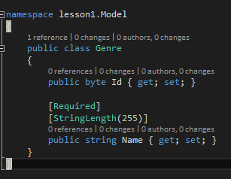
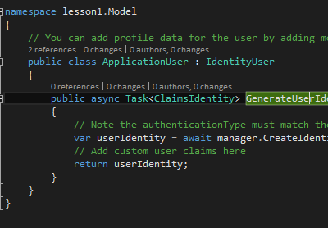
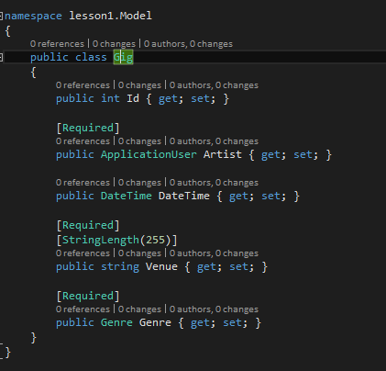
Extending the model
Now with a quick analysis we can guess the classes we want. But when it comes to a large enterprise system you have to follow rest of the object oriented design process and come up with a final class diagram .
So as following we add the classes one by one.

Slide 22


Property Attributes
Where did these come from?
These are called property attribute. They are enhancing and give the new features to properties.
When we set these attributes EF will track them and covert them in to relevant schema attributes when needed.
For example when put REQUIRED then EF mark it as Not null in the SQL schema.
You can specify STRINGLENGTH when you need nvachar length of the SQL column

Slide 23
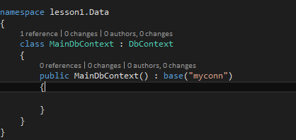
Data Access Project
Next thing we have to do is adding the dataacces project to our solution. Right click on the solution and add new class library project named “lesson1.Data”
then configure Entity Framework to that project as we do it in the model project
Add a class name MainDbContext to the project. This class will represent the context of our logical model. In other words this file represent in memory database schema of our actual database.
Then we implement DbContext base class from the entity freamwork to MainDbContext class. This will officially make MainDbContext class as a Logical model in the project.
Then we call the base class’s constructor and give it the connection string’s name witch will be on our app.config file.

Slide 24
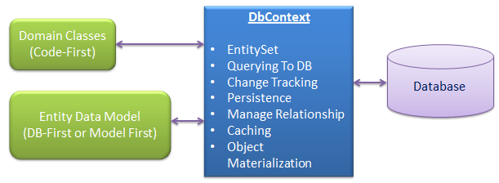
DbContext and DbSet<>
DbContext is an important part of Entity Framework. It is a bridge between your domain or entity classes and the database.
As shown in the above figure DbContext has lots of configurable lists those represent and manage the database. One we more interested here is EntitySet
EntitySet represent one data table on the actual database. This EntitySet will represent the DbSet<TEntity> where Tentity is a class of our model
So far we have 3 classes in our model and we put them as 3 properties in our context class

Slide 25
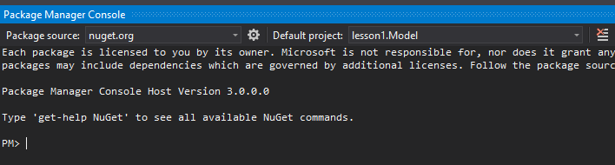
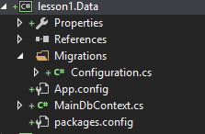
Database Migrations
Now we added our classes to context and it’s time for the migrations. On the project search type pack and click on the package manager console.
And then select the data project that on the top list .
And type following command to Enable migrations on the project
(enable-migrations)
This will add the migration metadata in to the project. What this does is it will make stage for the next events to come.

Slide 26
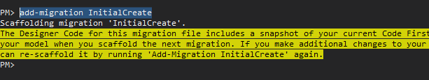
Adding Migrations
When a project build is in progress we have to make changes to the database. Like that we have to change this context time to time. Each time logical model changes we change the our model. When model changes we have to add one migration to put those changes to the database
This will done using following command
add-migration InitialCreate
When the first time create we name this migration as initial Create. When you change model again and again name this accordantly.
This will add <datestamp>_InitialCreate.cs file in the data project that will hold the meta data for this migrations.
UP() method will responsible for implement this changes on the database . The Down() method will responsible for rollback of that changes from the database. You can customize this when ever you nee

Slide 27

Update the Database
With every thing ready we can update the migrations to database. This can be done by running following command
update-database.
And if you need to show the sql script is being running behind the screen you can run following command instead
update-database –script
By showing the scripts helps every time because we can show what’s going on when schema updating and if something wrong then we can make changes and update the model again.

Slide 28

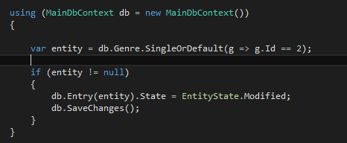
CRUD Operations
To add data to the database we first have to get an instance of the context. Then we can access the DbSets associated with it.
To update add we can select existing record and then update it using SaveChanges() on context. we can use the Entry update that will attach the object in to the DbSet and mark the state as updated.

Slide 29
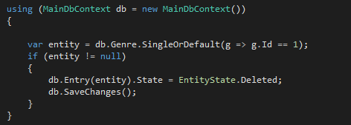

Delete And Filtering
To delete just change the DbSet state to deleted. And save changes
Get all the records

